Slide 1
Lab 3 – Multiple Servers & Event OOP

Slide 2
Level 5: Discrete Event Simulator
Variables in green, Methods in purple
PriorityQueue events
waitingCustomer
server
servingCustomer
Simulator
has
Server
isFree()
addEvent(Event e)
run()
serveCustomer(Cust c)
serves
type
time
Implements Comparable
id
Event
static nextId
Customer
arrivalTime
serveTime
getWaitingTime()
inherits
Number of customers left
static addWaitingTime()
static addCustomerServed()
ArrivalEvent
ServeEvent
DoneEvent
Statistics
static addCustomerNotServed()
static addEvent(LogEvent e)
print()
Log
has
LogEvent
type
time

Slide 3
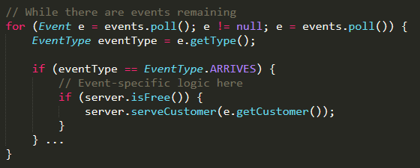
(As of L5) Event Handling – Most Basic Way
server
PriorityQueue events
Simulator
addEvent(Event e)
run()

Slide 4

(As of L5) Event Handling – OOP Way
server
PriorityQueue events
Simulator
addEvent(Event e)
run()

Slide 5
Improvement
Variables in green, Methods in purple
PriorityQueue events
waitingCustomer
server
servingCustomer
Simulator
has
Server
isFree()
addEvent(Event e)
run()
serveCustomer(Cust c)
serves
type
time
Implements Comparable
id
Event
static nextId
Customer
execute()
arrivalTime
serveTime
getWaitingTime()
inherits
Number of customers left
static addWaitingTime()
static addCustomerServed()
ArrivalEvent
ServeEvent
DoneEvent
Statistics
static addCustomerNotServed()
static addEvent(LogEvent e)
print()
Log
has
LogEvent
type
time

Slide 6
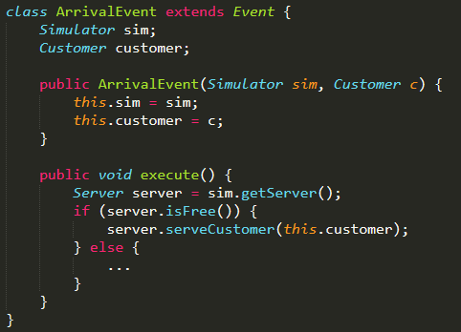
Events
Each Event has its own constructor that takes what it needs
Execution does not require any parameters

Slide 7
(Extra Info)
This is called the Command Pattern https://en.wikipedia.org/wiki/Command_pattern
If you’re interested in design patterns & software engineering, look @ CS3219

Slide 8
Class Diagram after L5
Variables in green, Methods in purple, classes you NEED are in Orange
IMPORTANT: If you haven’t gotten here yet, don’t try to skip ahead!!!
PriorityQueue events
waitingCustomer
server
servingCustomer
Simulator
has
Server
isFree()
addEvent(Event e)
run()
serveCustomer(Cust c)
serves
type
time
Implements Comparable
id
Event
static nextId
Customer
execute()
arrivalTime
serveTime
getWaitingTime()
inherits
Number of customers left
static addWaitingTime()
static addCustomerServed()
ArrivalEvent
ServeEvent
DoneEvent
Statistics
static addCustomerNotServed()
static addEvent(LogEvent e)
print()
Log
has
LogEvent
type
time

Slide 9
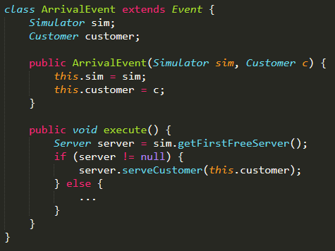
Level 6: Multiple Servers
Change needed for L6
Even if you implemented it the “basic way”, it’s the same logic & easy to convert so if you haven’t done so already, do it first!

Slide 10
Today’s Lab
Pre-L1: Enhance existing solution if needed
L1: Implement Priority Queue (Done ☺)
L2: Create a cs2030.simulator package
L3 & 4: Randomize arrival time and service duration using provided RNG

